Slide 1
Plastic Trends
From around the globe
Miles Lane

Slide 2
Today’s agenda:
Questions
Data
Findings
Future work
Questions?

Slide 3
Questions

Slide 4
Where?
Global distribution
When?
2019 → 2020
Who?
Corporate responsibility

Slide 5
Data

Slide 6
Source
Break Free from Plastic Brand Audit
Global data
Completed in October 2020

Slide 7
Prep
“NA”s in consistent places → Imputed 0.0
Different strings, same company → Replaced values
Needed more context → Added sales, industry data

Slide 8
Findings

Slide 9
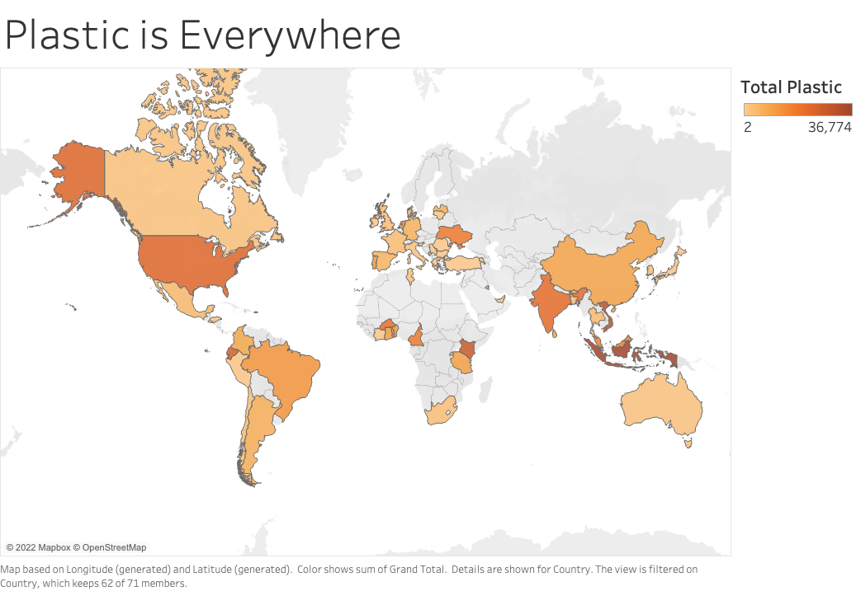

Slide 10
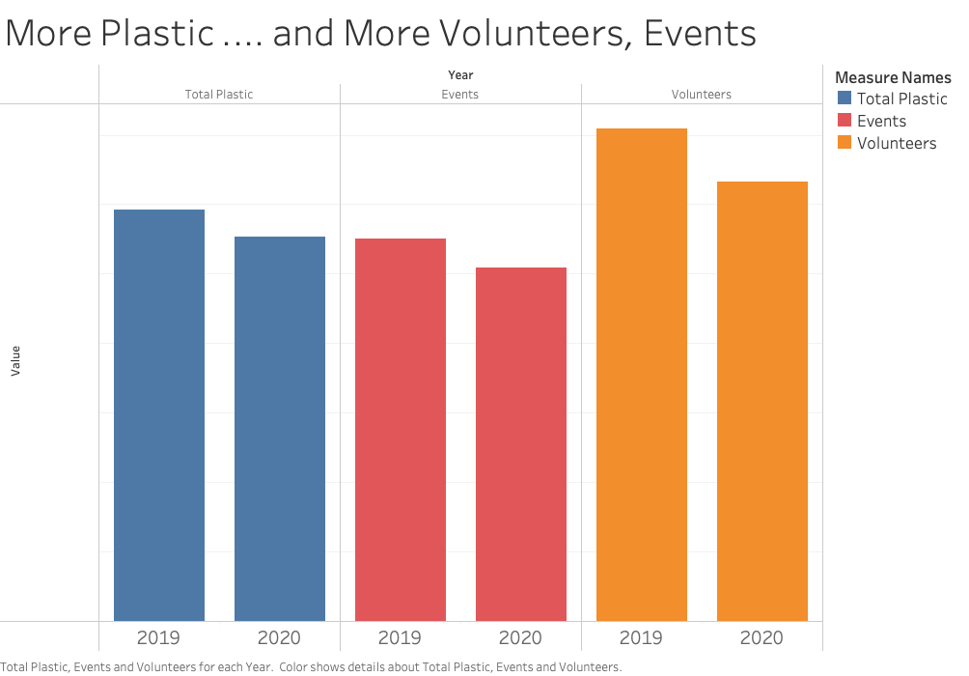
Notes:
Explanations:
Higher plastic to volunteer ratio in 2020 → decreasing marginal returns
All the plastic was already picked up in 2019

Slide 11
We are an advocacy group.

Slide 12
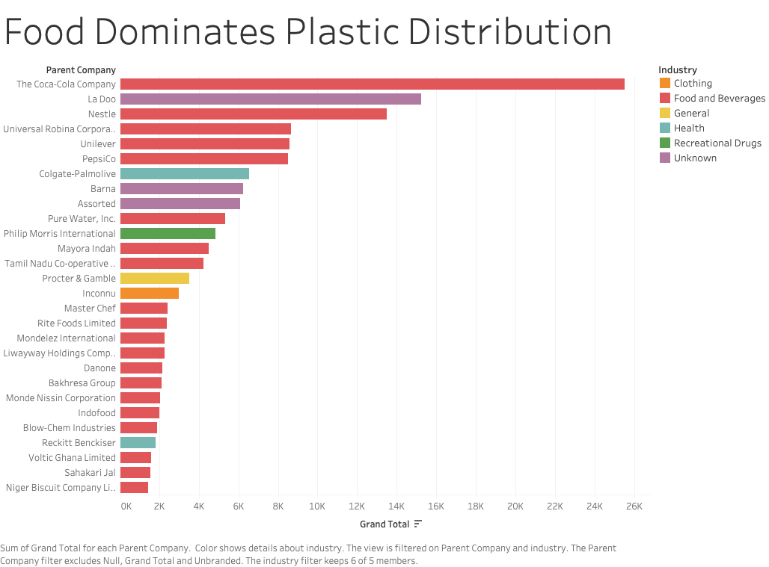

Slide 13
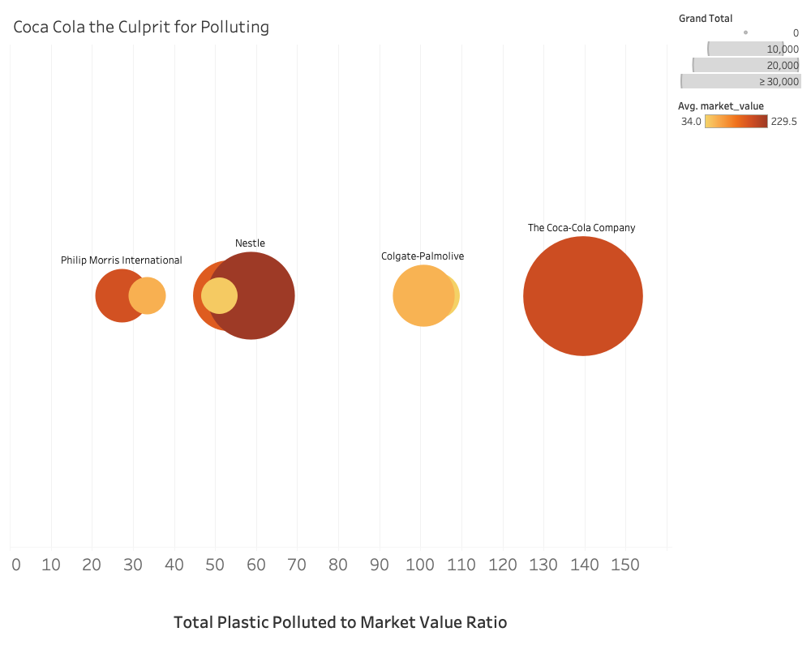

Slide 14
Future Work

Slide 15
Analyze other companies
Find more data
Target big culprits

Slide 16
Questions?

